Slide 1

Sales Distribution Dashboard: Performance Overview
This presentation will analyze our sales distribution dashboard, diving into key insights and performance metrics for optimizing our sales strategies. We'll explore trends in product distribution, regional variations, and individual sales representative performance, offering actionable recommendations to boost sales and improve efficiency.

Slide 2

Product Distribution Trends
Top-Performing Products
Growth Opportunities
Product 30 leads the sales distribution with consistent high performance over the year. Product 41 follows closely, showing steady growth potential. Product 24 has experienced a decline in sales over the past few months, indicating a need for re-evaluation and potential adjustments to our marketing and sales strategies.
Products 19 and 22 are showing promising signs of growth, with a steady increase in sales over the past quarter. Further analysis can identify the factors driving this growth and provide insights for maximizing their performance. Similarly, product 32 shows promising potential and deserves attention in our strategies.

Slide 3
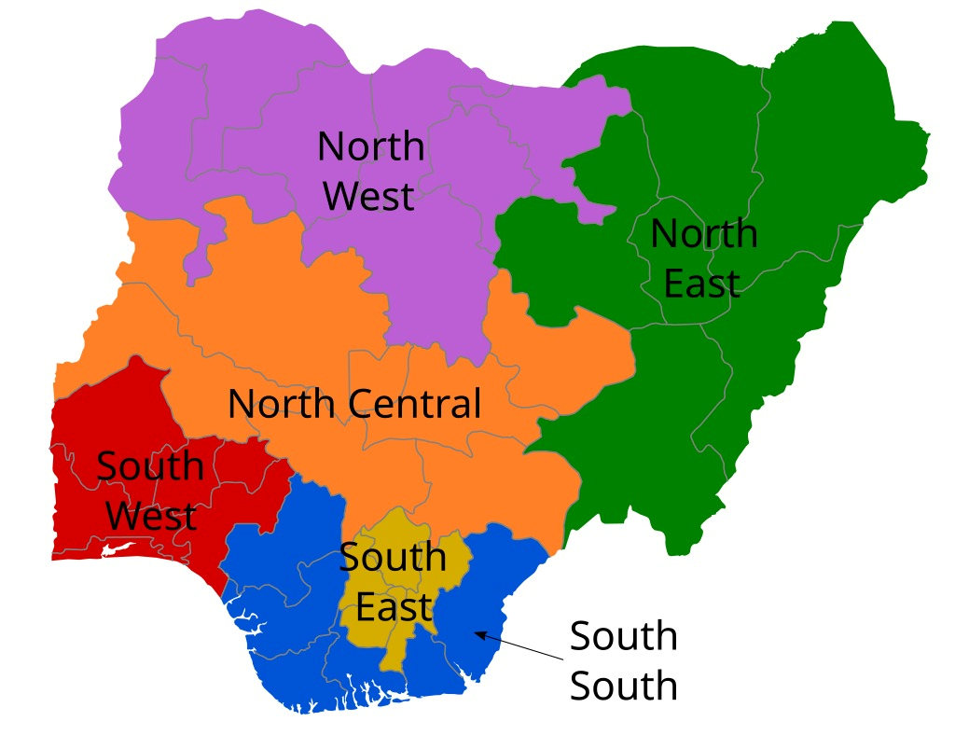
Regional Performance Analysis
Midwest
Southeast
The Midwest has seen a slight decline in sales in recent months, requiring further analysis to understand the underlying factors.
Sales in the Southeast have remained stable, with room for growth through targeted initiatives.
Western
Export
The West region has demonstrated potential for significant growth, with promising performance in key markets.
The Export region continues to be a strong performer, contributing significantly to our overall sales revenue.

Slide 4

Individual Sales Representative Performance
Top Performers
Sales Representative 05
Sales Representative 42
Sales Representative 10
Areas for Improvement
Sales Representative 21
Sales Representative 19
Sales Representative 22

Slide 5

Monthly Sales Trends
January
1
Sales start the year strong, driven by post-holiday promotions and seasonal demand.
2
March-May
Sales experience a significant increase, reflecting a peak season for the industry.
June-August
3
Sales stabilize, with slight seasonal fluctuations depending on specific product categories.
4
September-December
Sales typically increase again, leading up to the holiday season and year-end promotions.

Slide 6




Key Takeaways and Recommendations
Targeted Product Marketing
Regional Expansion Strategies
Sales Team Performance Optimization
Focus marketing efforts on top-performing products and those with growth potential, adapting strategies based on specific product characteristics.
Explore strategic expansion opportunities in high-potential regions like the West, leveraging localized marketing campaigns and sales initiatives.
Provide targeted coaching and training to enhance sales representative performance, leveraging best practices and individual strengths.

Slide 7




Actionable Insights
Product 30 Analysis
Conduct a thorough analysis of Product 30's sales performance, identifying key drivers and opportunities for further optimization.
West Region Strategy
Develop a comprehensive strategy for expanding into the West region, including market research, target audience identification, and tailored marketing campaigns.
Sales Team Training
Implement a comprehensive training program to equip sales representatives with the knowledge and skills to excel in their roles, enhancing their ability to effectively close deals and drive sales growth.

Slide 8

Next Steps and Conclusion
By implementing the actionable insights discussed, we can capitalize on emerging trends, strengthen our sales distribution, and achieve significant growth in the coming year. Our commitment to data-driven decision-making, combined with a focused approach to strategic initiatives, will drive our sales success and solidify our position as industry leaders.

